Slide 1


GraphQL
with Flutter
Yash Dhrangdhariya

Slide 2
Why
GraphQL?
It’s a Query Language for your API. And a service-side runtime for executing those queries.​
Query Language is specialised language used to request and retrieve specific information or data from a database (Ex. MongoDB).
it's designed to communicate with and manipulate data by defining structured queries that specify that what data you want and how to filter or sort it.​
The availability of strongly typed fields that alerts developers to errors before running a query.​
Developed by: Facebook
Released as Open-Source
Companies like Facebook, Twitter, Pinterest, GitHub.​

Slide 3
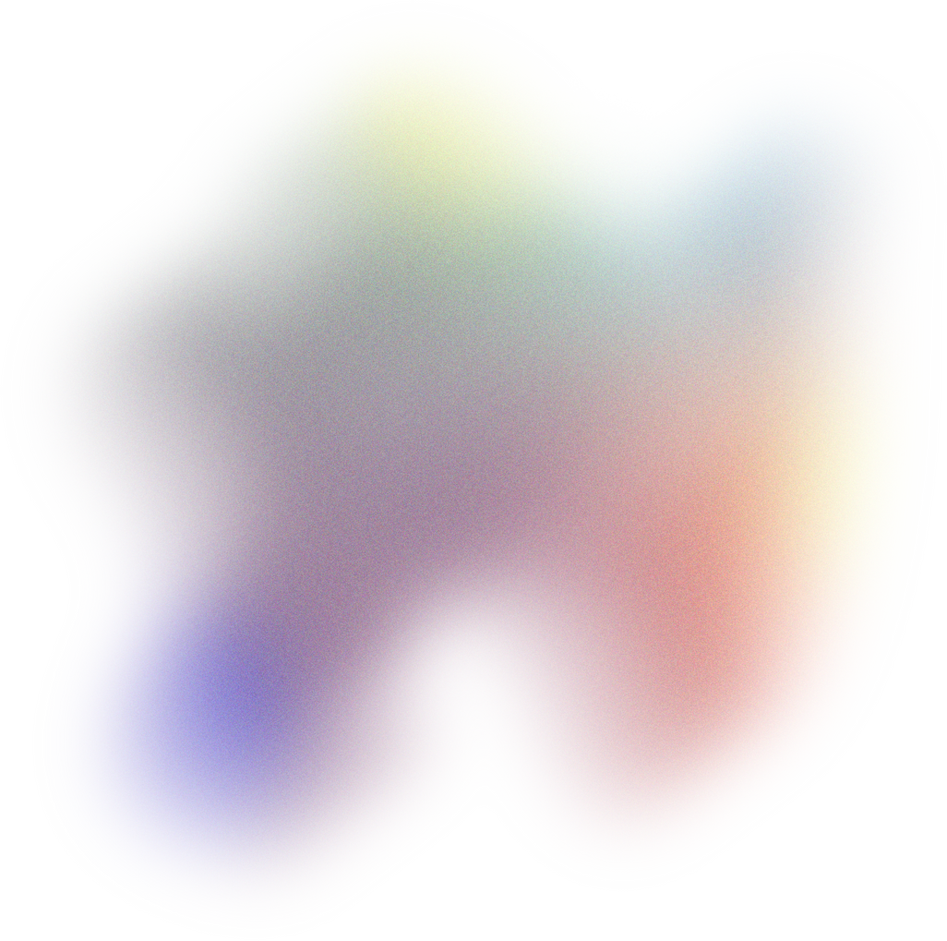
Agenda
Comparison of GraphQL with RestAPI​
Q&A
Demo
GraphQL Operations​
References
GraphQL Structure​
GraphQL Schema​
GraphQL Types​

Slide 4
Comparison of GraphQL with RestAPI​
 | GraphQL | RestAPI
Query Flexibility​ | Multiple Data Receive in Single Request. Reduces OF & UF | Fixed data in Single Request. Often OF & UF
Endpoint | Single => Ex: "URL/graphql,".​ | Multiple => Ex. GET /users, POST /users, GET /posts​
Versioning | Doesn't require versioning. | Often necessitates versioning (e.g., /v1/ or /v2/)​
Caching | More complex due to flexibility in query ​ | More straightforward because predictable results on endpoints.​
Real-time Data​ | Through Subscription | Required additional technologies like WebSockets.
Performance​ | Depends on efficiency of resolvers and schema is design. | Depends on the number and size of requests
OF: Over Fetching, UF: Under Fetching​

Slide 5
GraphQL Operations
Query
Mutation
Subscription
It’s used to retrieve data.
In the query you define the structure of the data you need in the query, and the server returns the exact data you requested.
GraphQL queries are executed in a "get" fashion.​
It’s used to modify data. ​ ​
It allow you to specify what data you want to change and what data you want to receive in response.​
They are equivalent to the "create," "update," or "delete" operations in RESTful APIs.
They allow clients to subscribe to real-time updates from the server. ​
When something changes on the server, such as new data being added, a subscription pushes that data to the clients that are subscribed to it. ​

Slide 6
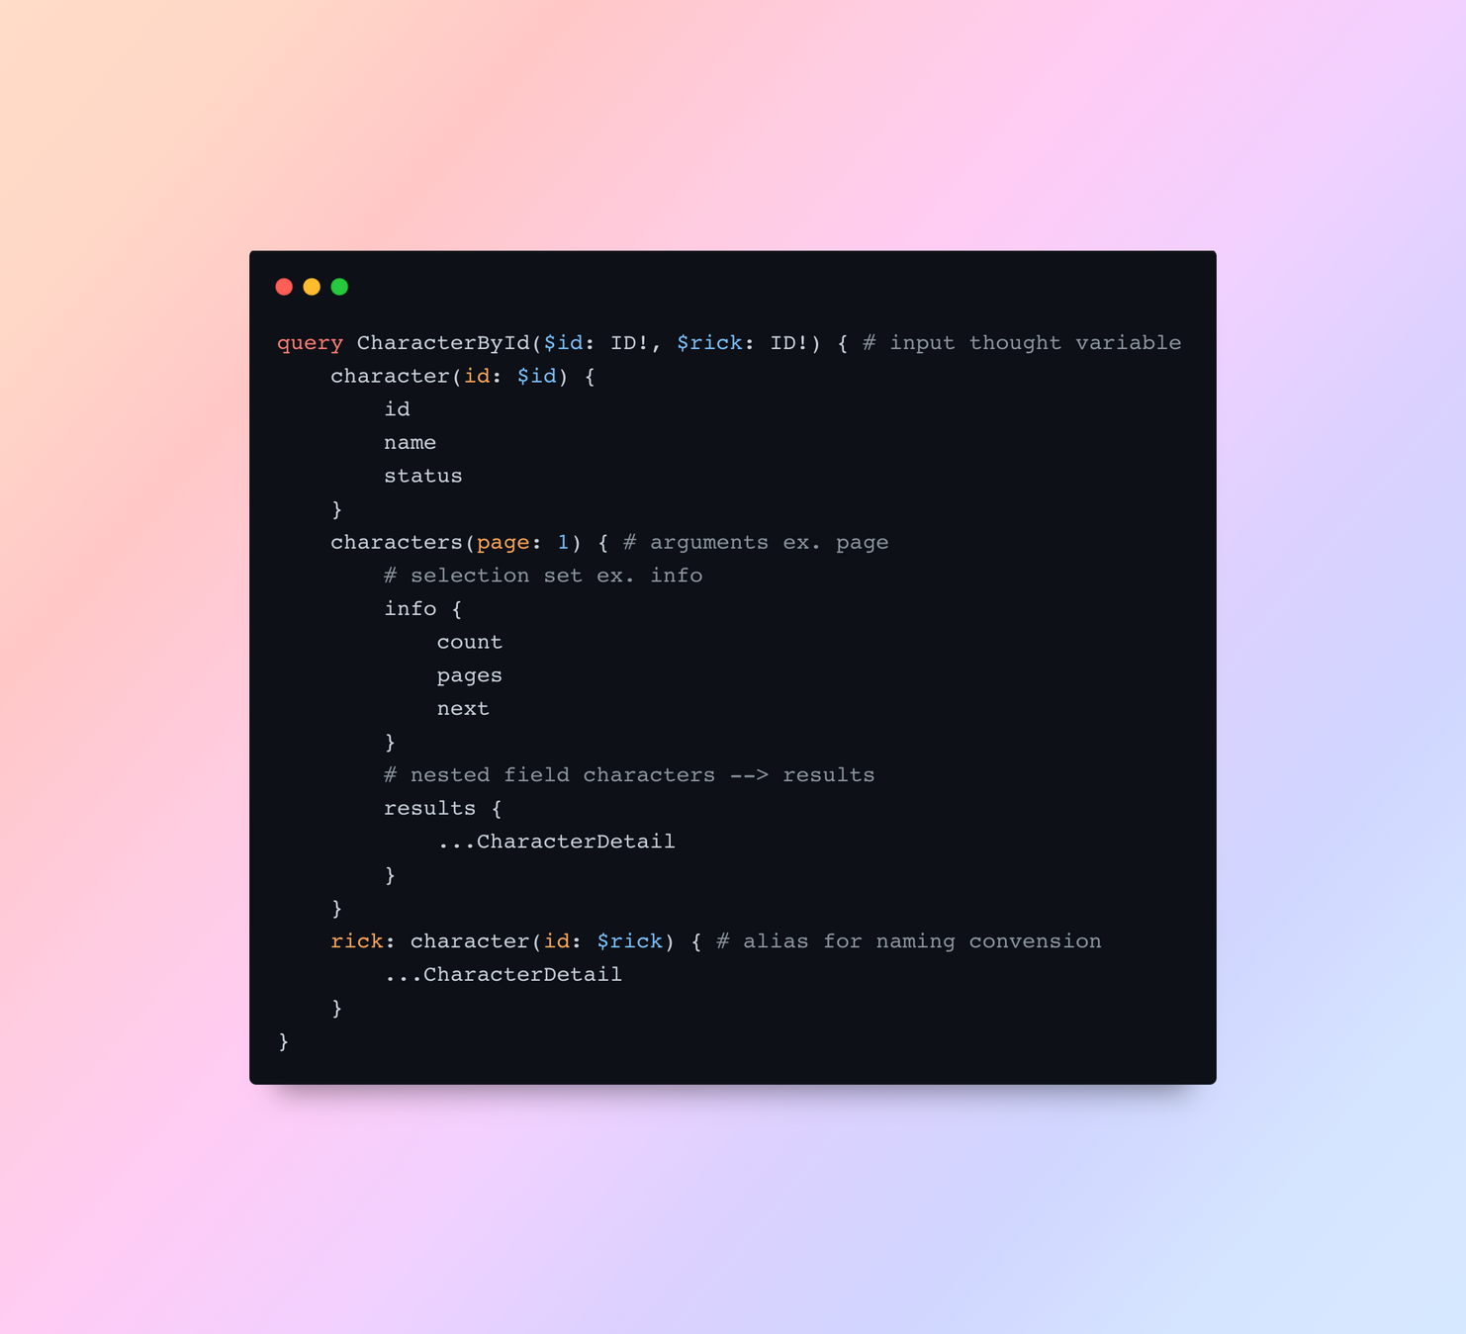
GraphQL Structure
GraphQL query has a specific structure that consists of various components.
Operation Type​
Selection Set​
Nested Fields​
Arguments​
Variables​
Aliases​
Fragments​​

Slide 7
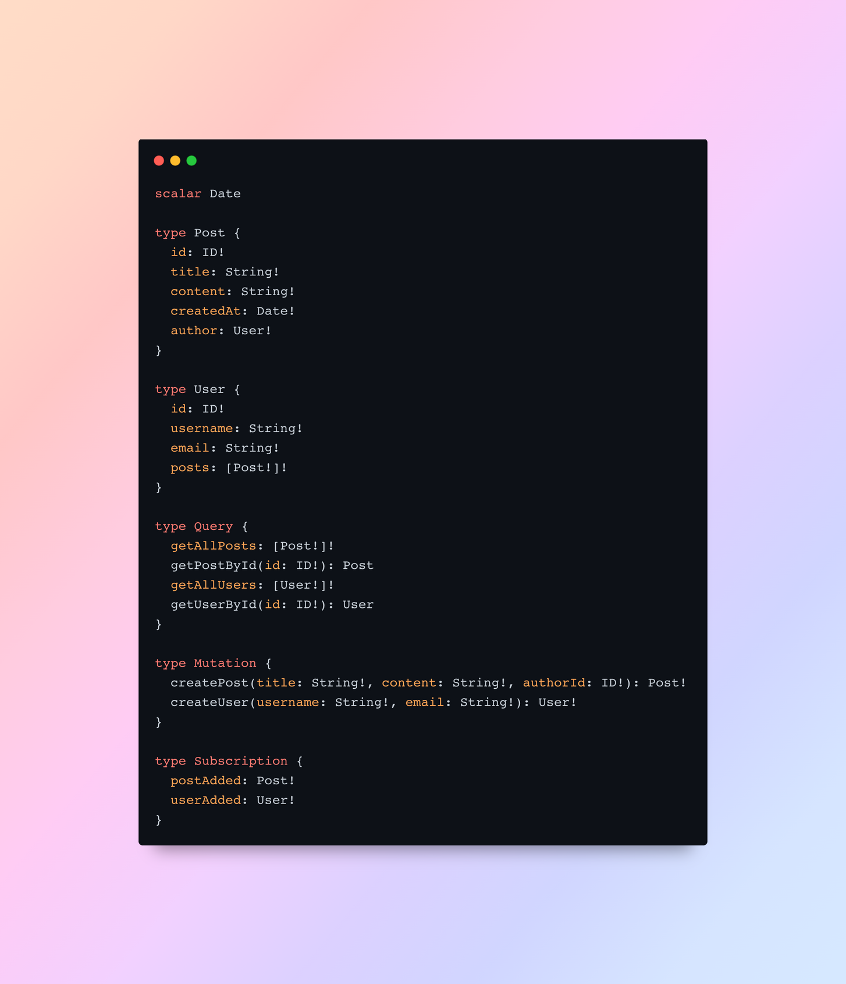
GraphQL Schema
It defines the structure of the data that can be queried or mutated.​
​​The schema serves as a contract between the client and the server, specifying the available types of data and the operations that can be performed on them.​
In GraphQL Schemas are often defined using a human-readable Schema Definition Language (SDL).​
Schema Definition Language (SDL): The SDL is a concise way to declare types, their fields, and relationships.​

Slide 8

GraphQL
Types
There are three main categories of types: ​
Scalar Type
Object Type
Root Type
Schemas are composed of various types. Where Types represent different kinds of data that can be queried or mutated.​

Slide 9
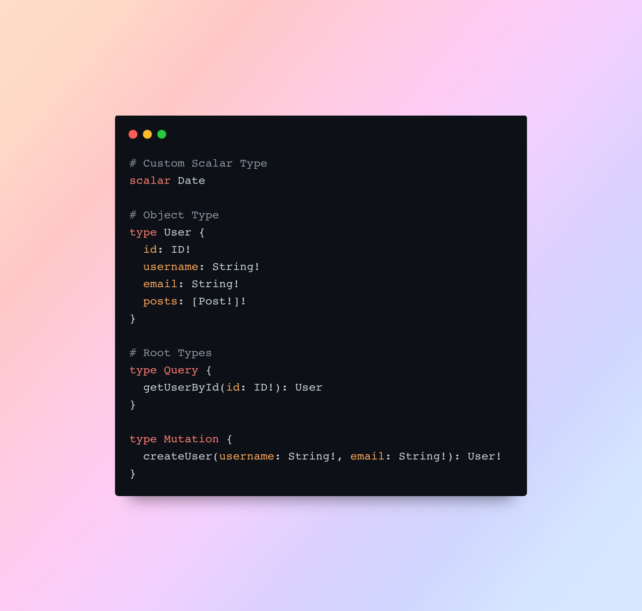
Scalar Types:​
These are single-value types, such as Int, String, Boolean, Float, and ID, Custom Scalar. ​
Object Types:​
Object types define complex, structured data with multiple fields.​
Fields: ​Fields have names and types.
(Example: Scalar, Object, List of values)
Fields are queried within an object type.
Root Types:​
It's an entry point of GraphQL Schema.​
A GraphQL schema typically has Three root types
Query Type
Mutation Type
Subscription Type.
Each root type corresponds to a fundamental operation.​​

Slide 10

Have a Question in mind?
Thank you for listening!

Slide 11

Let’s jump to the Demo...

Slide 12
References
GraphQL:
https://graphql.org/learn/
Flutter GraphQL Packages:
graphql
graphql_flutter
graphql_codegen
APIs used:
https://rickandmortyapi.com/graphql
https://snowtooth.moonhighway.com
Git Repository:
https://github.com/dhyash-simform/graphql_demo

